Slide 1
Intro to R Tidyverse Packages
Amit Talapatra

Slide 2
Setup
Download and Install R: https://www.r-project.org/
Download and Install RStudio: https://rstudio.com/
Run these lines in RStudio to install the packages we’ll be using:

Slide 3
Tidyverse Resources
Tidyverse Website
David Robinson's ‘Teach the Tidyverse to Beginners’
Hadley Wickam’s Paper “Tidy Data”

Slide 4
What is the tidyverse?

Slide 6
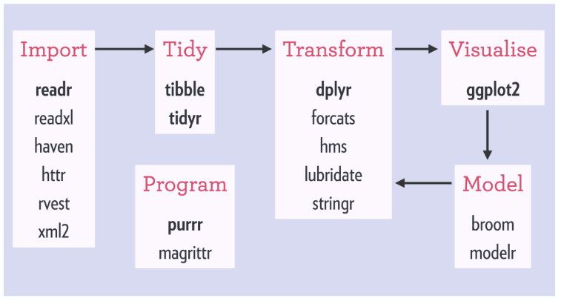
https://github.com/rstudio/rstudio-conf/blob/master/2018/TeachTidyverse-DavidRobinson/TeachTidyverse-DavidRobinson.pdf

Slide 7
Tidy
tibble
tidyr
Transform
dplyr
tidytext
Visualize
ggplot2
tidygraph
Import
readr

Slide 8
readr
Pipes (%>%): https://uc-r.github.io/pipe
Functions (https://dplyr.tidyverse.org/):
mutate() adds new variables that are functions of existing variables
select() picks variables based on their names.
filter() picks cases based on their values.
summarise() reduces multiple values down to a single summary.
arrange() changes the ordering of the rows.

Slide 9
dplyr
Pipes (%>%): https://uc-r.github.io/pipe
Functions (https://dplyr.tidyverse.org/):
mutate() adds new variables that are functions of existing variables
select() picks variables based on their names.
filter() picks cases based on their values.
summarise() reduces multiple values down to a single summary.
arrange() changes the ordering of the rows.

Slide 10
ggplot2
General information on ggplot2: https://ggplot2.tidyverse.org/reference/ggplot.html
ggplot2 cheat sheet: https://rstudio.com/wp-content/uploads/2015/03/ggplot2-cheatsheet.pdf
Leland Wilkinson’s The Grammar of Graphics https://www.amazon.com/Grammar-Graphics-Statistics-Computing/dp/0387245448
Hadley Wickam’s A Layered Grammar of Graphics https://vita.had.co.nz/papers/layered-grammar.html

Slide 11
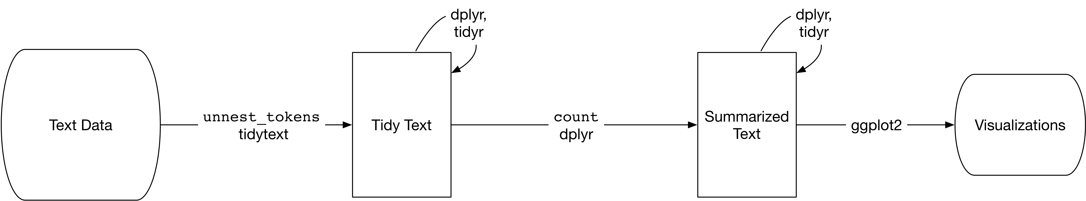
tidytext
Introduction to tidytext: https://cran.r-project.org/web/packages/tidytext/vignettes/tidytext.html
Additional examples: https://www.tidytextmining.com/tidytext.html
Source: https://www.tidytextmining.com/tidytext.html

Slide 12
tidygraph
Network graph data is stored as edges and nodes, which is not a traditional format for “tidy” data.
Tidygraph enables users to manipulate graph data using dplyr. Graph data can then be plotted using traditional network graph packages (e.g. ggraph, igraph).
More info on tidygraph: https://www.data-imaginist.com/2017/introducing-tidygraph/

